Slide 1
Using Windows Forms Quick and Simple
Just to access Databases

Slide 2
First watch these 4 videos
https://www.youtube.com/playlist?list=PL8VznjN11Vo6jrnJmb3owJ290Cp1Gl5x5

Slide 3
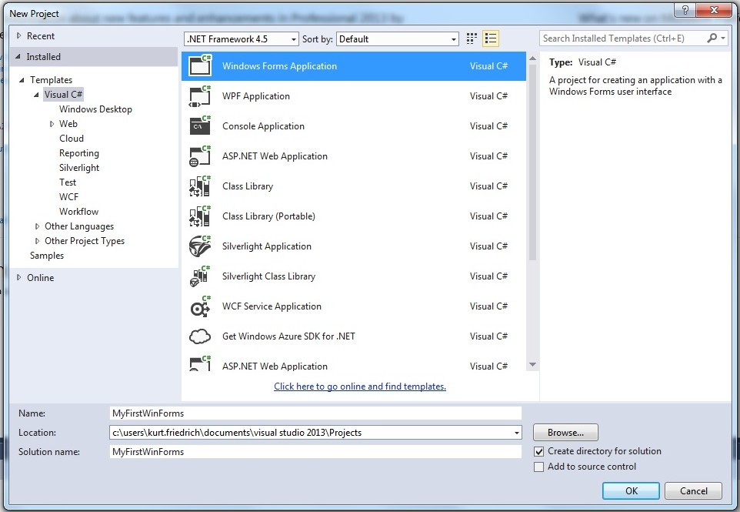
Start a new project:

Slide 4
Grab a corner and stretch out the form to be larger
Using the Toolbox, drag in a ListView, and grab a corner of that and stretch it out.
Double click in the gray area of the form (not in the ListView), and that will generate a form load button, where you can execute C# code to initialize the form. It will also take you to the “code behind” for the form. (you can always type F7 to see the code behind the Form)

Slide 5
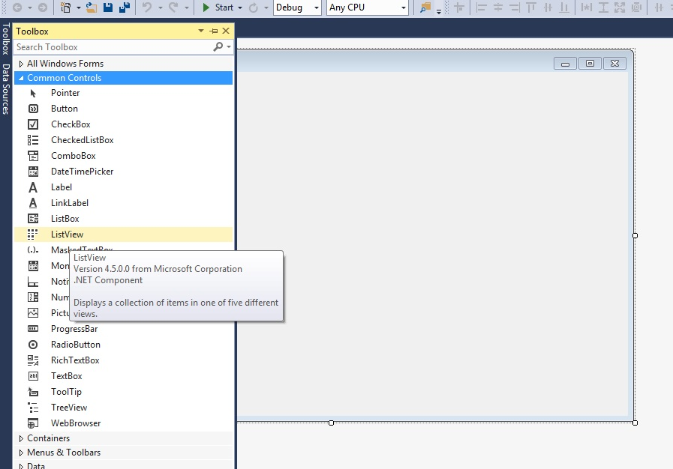

Slide 6
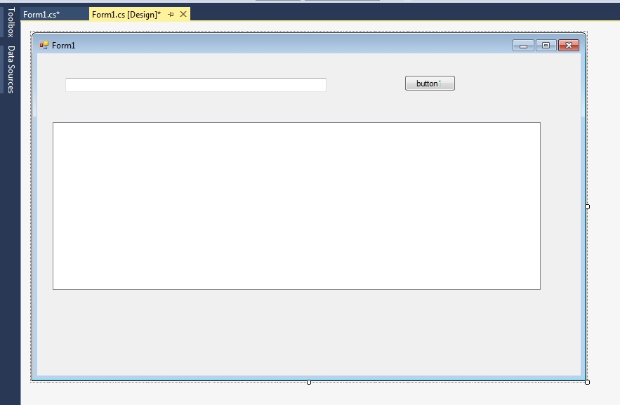
Drag in a text box and a button onto your form
Double click the button to create the C# event method

Slide 7
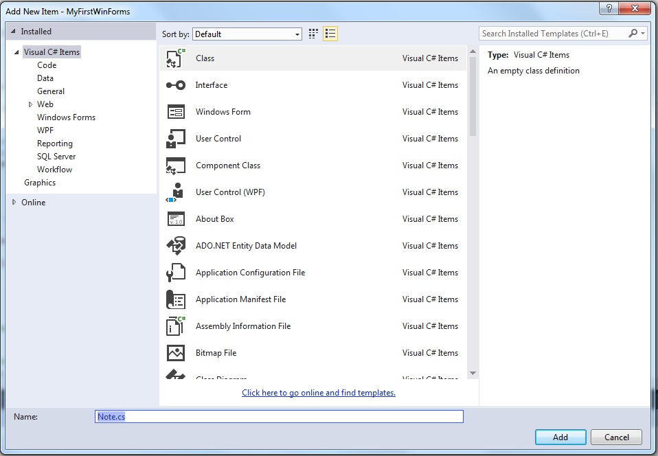
Add a new class to the project called Note

Slide 8
Paste in this code
public class Note
{
private DateTime _date;
private static int _NoteNumber = 0;
private string _text = "";
public Note(string newText) // constructor sets the Date field to "now"
{
_date = DateTime.UtcNow;
_NoteNumber++; // bump up our count of Notes
_text = newText; // set the text
}
// Class Properties
public string NoteNumber // each "record" gets a new, unique NoteNumber
{
get { return _NoteNumber.ToString(); }
}
public string Text // the text for our Note
{
get { return _text; }
}
public DateTime Date // can read this property, but it is set only in constructor
{
get { return _date.ToLocalTime(); }
}
}

Slide 9
Now add the code in the Form1.cs Form1_Load method
listView1.BackColor = System.Drawing.Color.Blue;
listView1.ForeColor = System.Drawing.Color.White;
listView1.BorderStyle = BorderStyle.Fixed3D;
listView1.View = View.Details;
listView1.Columns.Add("Note Number", 80, HorizontalAlignment.Left);
listView1.Columns.Add("When", 140, HorizontalAlignment.Left);
listView1.Columns.Add("Note", 400, HorizontalAlignment.Left);
listView1.GridLines = true;
// this sets up appearance, puts it in detail mode (rather than icon mode, think of Windows File Explorer as a ListView)
// and then it creates 3 columns, with widths and header names

Slide 10
Now add the code in the Form1.cs button1_Click method
Note nextNote = new Note(textBox1.Text); // create a new note from text user entered
// then add the 3 pieces of data from our new object to the ListView
listView1.Items.Add(nextNote.NoteNumber);
listView1.Items[listView1.Items.Count-1].SubItems.Add(nextNote.Date.ToString());
listView1.Items[listView1.Items.Count-1].SubItems.Add(nextNote.Text);
// listView1.Items.Count-1 gets the current listView item we just added
// -1 because like arrays, the first item in [0]

